Slide 1
ygrader A Python package to help automate grading
Jeff Goeders

Slide 2
ygrader
Used to help automate grading (or any other processing) of student submissions on LearningSuite (or Github)
What does ygrader do?
Reads in a CSV file with student grades + ZIP of submissions.
Matches submissions to students.
For each student (or group) that needs a grade:
Gets their (latest) submission
Extracts their files to a temporary directory.
Calls your callback function where you can do anything you want with the student’s submission, then return a grade.
CSV is updated with student(s) grade.

Slide 3
ygrader
Learning Suite
export
Empty CSV of grades
Zip of all student submissions
Your Python grader software
Student name, netid, section, etc.
Directory with submitted files
Callback Function
(used to grade
each student)
ygrader
Grade for assignment
CSV of grades
Learning Suite
import

Slide 4
Major Features
Supports “fully automated” grading
Make your callback return the student grade and it will automatically be recorded
You can run arbitrary Python code in your callback:
Build and run student software, run MATLAB, run SPICE, check for program outputs, etc.
Supports “partially automated” grading
If your callback doesn’t return a grade, the program will prompt for one.
You or TAs can run/view student submission and subjectively choose a grade.
Supports group-based assignments
Not just for grading
Useful for running analysis on student submissions (ie, run all code through plagiarism checker)

Slide 5
Install
pip3 install ygrader
Or, if you want to use the source code:
https://github.com/byu-cpe/ygrader
Notes:
In software, one thing changes at a time.
Can’t see everything

Slide 6
What does your Python need to do?
Create your callback function that will perform grading
Instance a ygrader.Grader object, configure it, and then run!

Slide 7
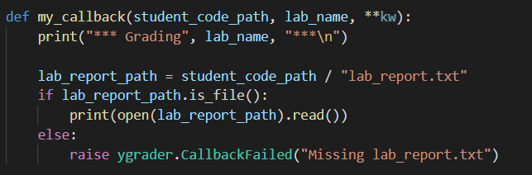
Simple Callback Example
This code looks for a submitted file called “lab_report.txt” and prints its contents:

Slide 8
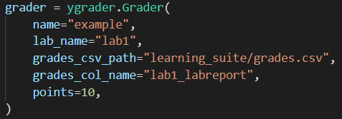
Configure Grader Object
Instance a grader object:
Name for this grading project
Name for this assignment (useful if your project can grade multiple different assignments)
Path to CSV with grades, and column name in CSV where grades should be put.
Maximum possible points for this assignment.

Slide 9
Types of Debugging
Simulation
Logic Analyzer
Scan Chain
Integrated Logic Analyzer (ILA)

Slide 11



Mocked Up Title
To Show How To Use This Page

Slide 12
Section Title Here
Subhead about the section

Slide 13
Section Title Here
Subhead about the section

Slide 14
Slide Title Here
Useful Subhead Here
Information about topic here
Place holder text
Longer place holder text
Short
Filler text

Slide 15
Slide Title Here
Information about topic here
Place holder text
Longer place holder text
Short
Filler text

Slide 16
Example slide with 2 columns (image or text)

